Slide 1
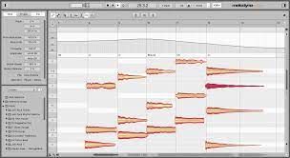
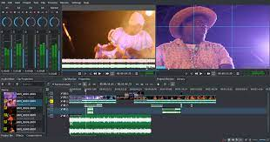
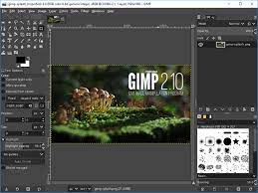
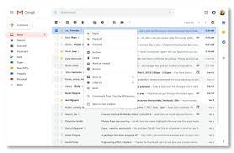
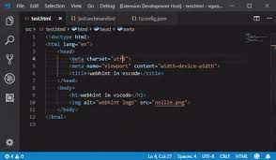
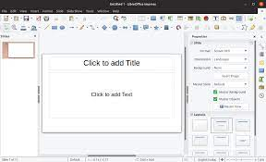
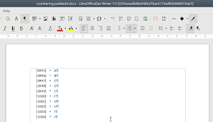
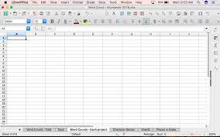

Search AppLaunch & open windows
Desktop 1
Desktop 2
Desktop 3

Slide 2
Search AppLaunch & open windows
Desktop 1
Desktop 2
Desktop 3
👉

Slide 3
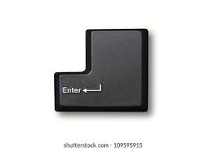
Search AppLaunch & open windows
Desktop 1
Desktop 2
👉
Desktop 3

Slide 4
Search AppLaunch & open windows
Desktop 1
Desktop 2
Desktop 3

Slide 5
Search AppLaunch & open windows
Desktop 1
Desktop 2
Desktop 3

